Slide 1

NBA Positionify
Leveraging Data Mining Techniques to Classify Professional Basketball Players into Positions
CS 2756 Term Project Presentation
Shinwoo Kim, Robbie Fishel, Birju Patel

Slide 2
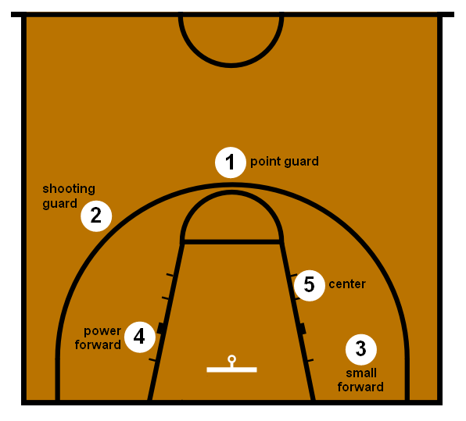
Motivation
The role of a player on professional basketball team is determined by
skill sets
physical prowess
tactical understandings
Traditional Positions
Can we use data mining techniques to effectively classify basketball players to appropriate positions?
Recent Trends
Lines between positions are blurred
Coaches use statistics to evaluate players and determine team strategies
Notes:
robbie

Slide 3

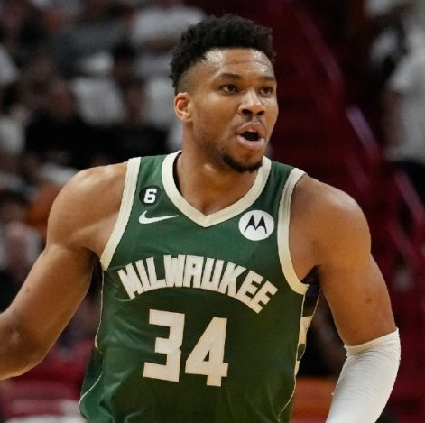
Motivation
Kevin Durant
Joined the NBA in 2008
Was a shooting guard in college at Texas and played there his rookie year
Over time he transitioned into a power forward
Giannis Antetokounmpo
Started as a point guard in 2016
Now plays as a power forward
Notes:
robbie

Slide 4
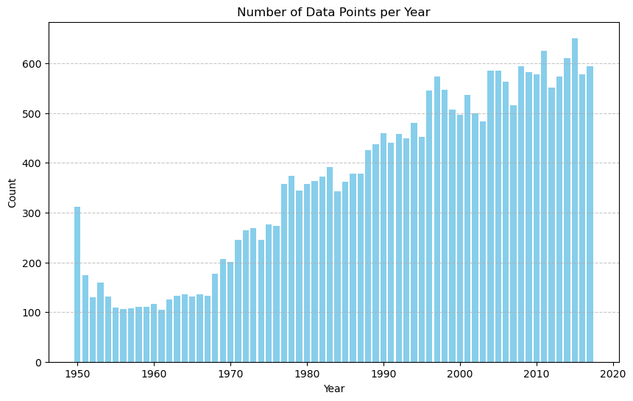
Methodology
Dataset from “Basketball Reference”
From NBA seasons since 1950
Player data: height, weight, college, etc.
Game data: points-scored, position played etc.
Classify Players by Position
Random Forest, XGBoost, Decision Tree
Determine decision rules and most important features
Clustering
Identify various playing styles
Outlier Analysis
Are famous players also statistical outliers?
Isolation Forest, Z-Score
Notes:
shinwoo

Slide 5
Dataset
Dataset Description
4500 players
24691 player-seasons
53 statistics per season
Data Cleaning
Remove entries with missing data
Players often played multiple positions in a single season
Year | Player | Pos | Age | Tm | G | GS | MP | ... | DRB | TRB | STL | BLK | TOV | PF
1950 | Curly Armstrong | G-F | 31 | FTW | NaN | NaN | NaN | ... | NaN | NaN | NaN | NaN | NaN | 217
Players who played as multiple positions
Missing Data
Notes:
shinwoo

Slide 6
Model Performance
Model | Decision Tree | XGBoost | Logistic Regression | Random Forest
Accuracy | 68.78% | 70.77% | 76.80% | 78.01%
Feature Selection
Joined player data and season data on player name
Derived player age from birthdate and season year
Derived BMI from height and weight
Trained model on every statistic provided
Random Forest classifier had the best performance
Notes:
birju

Slide 7
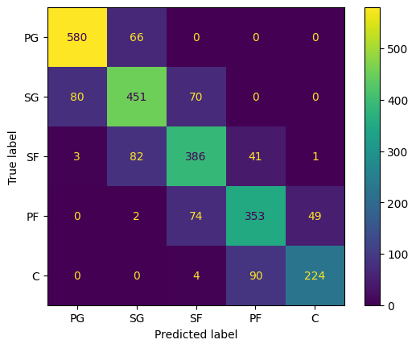
Model Performance
PG = Point Guard, SG = Shooting Guard, SF = Small Forward, PF = Power Forward, C = Center
Confusion matrix for random forest model
Data appears clustered, as points are usually misclassified to their neighboring classes
Notes:
birju

Slide 8
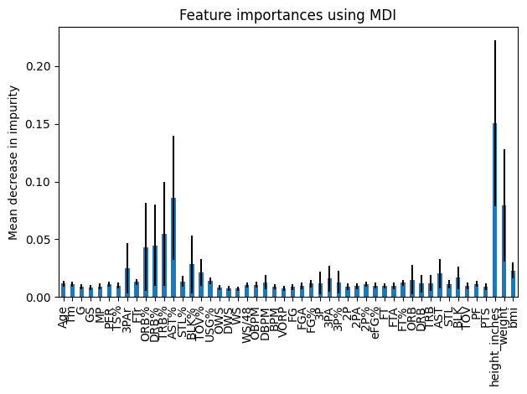
Most Important Features for Predicting Position
Top 10 Most Important Features
Features | MDI
Height | 0.150492
AST% | 0.085989
Weight | 0.079264
TRB% | 0.054982
DRB% | 0.044862
ORB% | 0.043170
BLK% | 0.028269
3PAr | 0.025008
BMI | 0.023135
TOV% | 0.021247
Notes:
birju

Slide 9
Most Important Features for Predicting Position
AST% - Percent of assists
TRB% - Percent of rebounds
DRB% - Percent of defensive rebounds
ORB% - Percent of offensive rebounds
BLK% - Percent of blocks
3PAr - Ratio of shots that were three point attempts
BMI - Body mass index
TOV% - Turnover percentage
Notes:
robbie

Slide 10

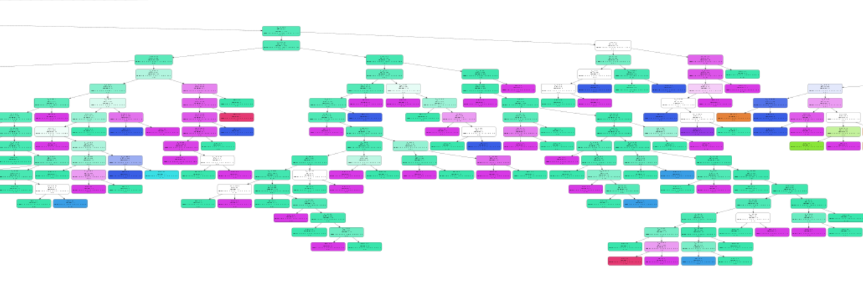
Investigating Decision Rules
Random forest model is too complex to uncover decision rules
Notes:
shinwoo

Slide 11
Investigating Decision Rules
Model Description
Trained a simple decision tree using only the most important features
Simple heuristic may be used by coaches and scouts
Max depth was restricted to 3
Accuracy - 68.78%
Insights
Point Guards and Shooting Guards are generally shorter
Power Forwards/Small Forwards/Centers are generally taller
Point Guards have more assists than Shooting Guards
Power Forwards make more rebounds than Small Forwards
Notes:
robbie

Slide 12
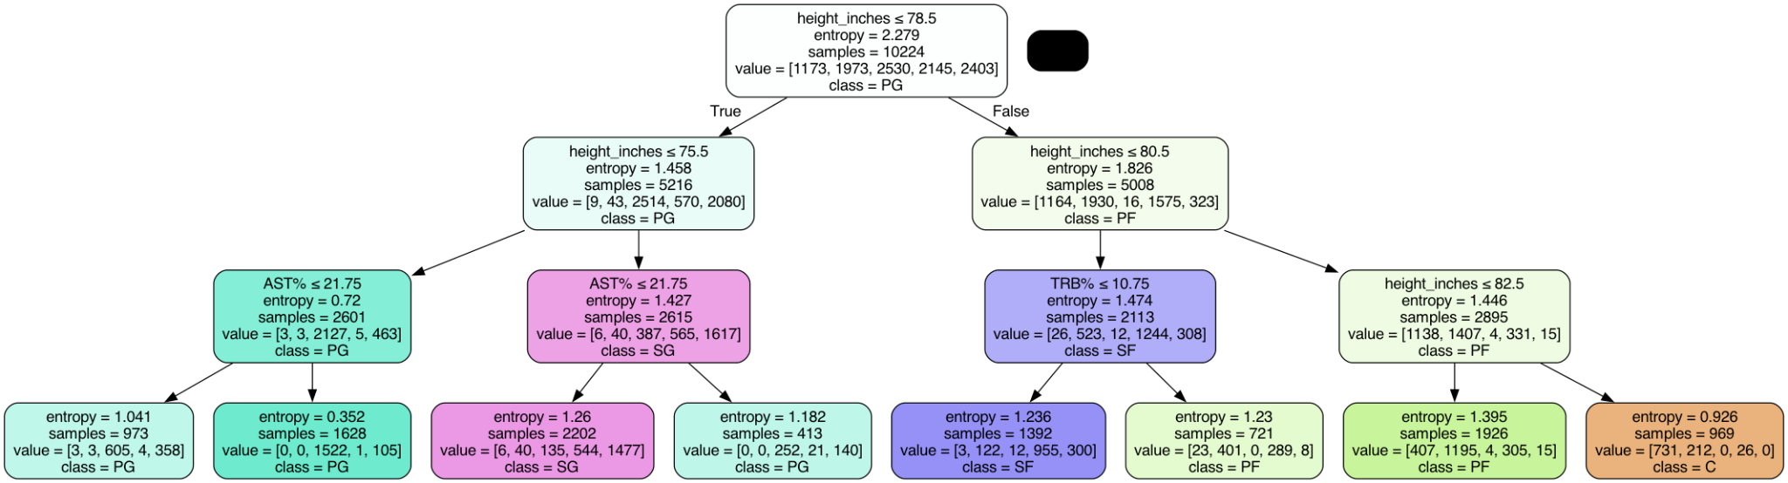
Investigating Decision Rules
Notes:
birju

Slide 13
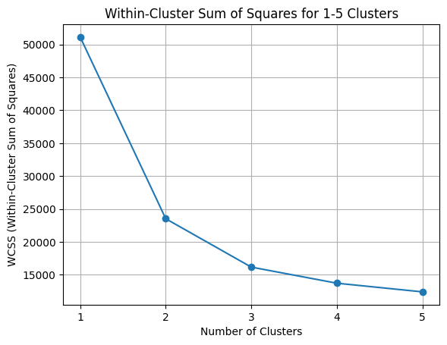
K-Means Clustering: WCSS
WCSS: Within Cluster Sum-of-Squares
Lower value -> data points closer to centroids
Ran K-Means clustering on the data with 1-5 clusters
Calculated WCSS for each
Took the cluster amount with min WCSS (5)
Notes:
robbie

Slide 14
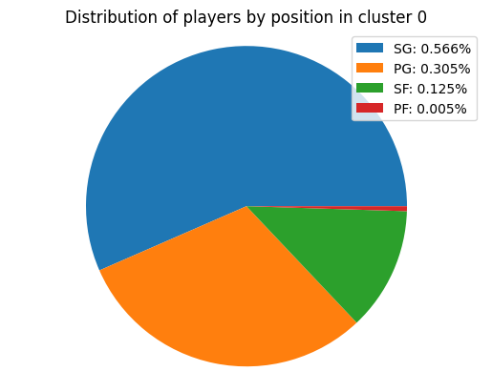
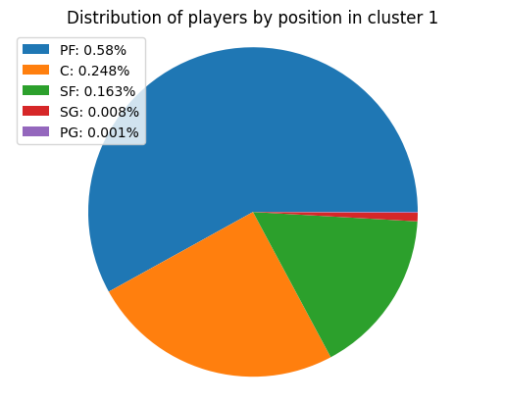
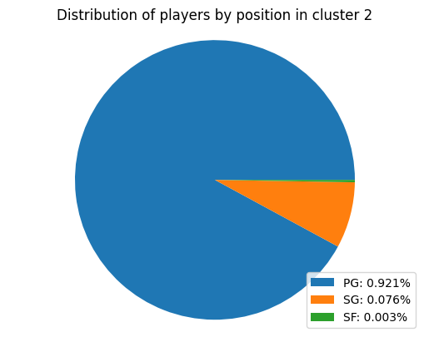
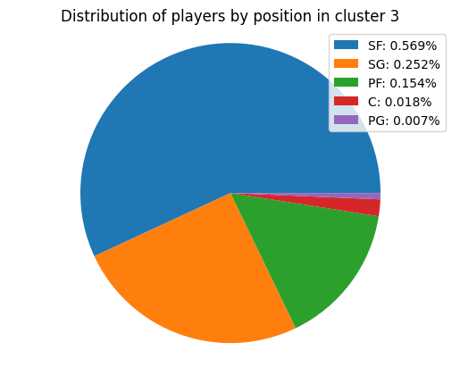
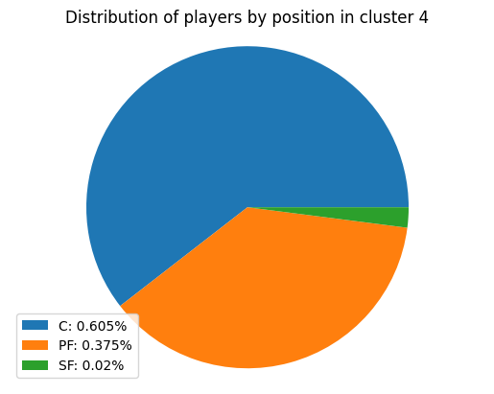
K-Means Clustering
5 Clusters with Data Normalization
Each cluster was mostly associated with one position
At least 50% of each cluster is in one distinct position category
Clusters from normalized data were more distinct to position
Notes:
robbie

Slide 15
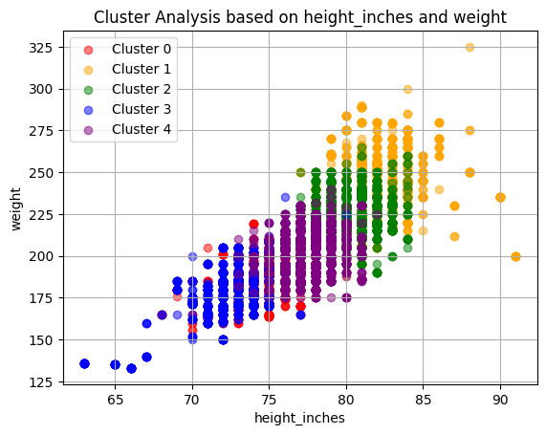
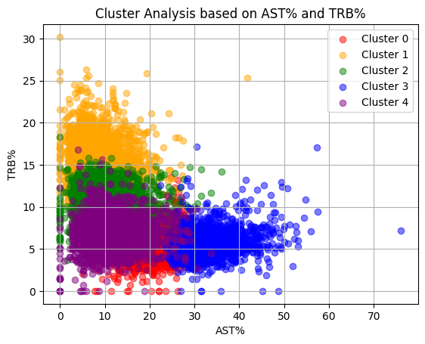
Agglomerative Clustering
5 Clusters with Normalization
Wanted to take more advantage of position “sub-groups”
Confirms that the relevant metrics are correlated with position
Notes:
robbie

Slide 16
Notable Outliers
Kevin Durant
Dataset had him listed as a SG in 2008, but was in a cluster with majority SF, PF, C
Giannis Antetokounmpo
Dataset had him listed as a PG in 2016, but was in a cluster with majority SF, PF, C
Both players are tall, score lots of points (not as many assists), and gather lots of rebounds
All qualities associated with forwards
Notes:
robbie

Slide 17
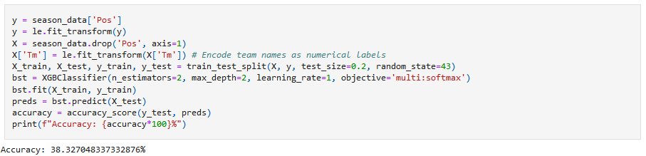

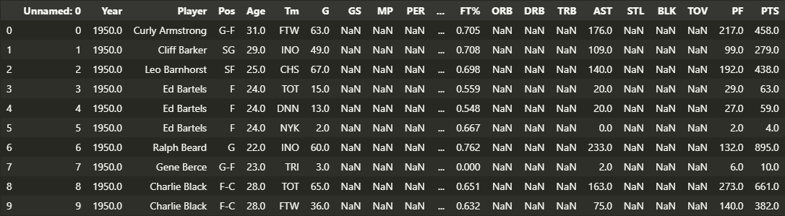
Failures Attempts
???
Notes:
shinwoo

